Slide 1
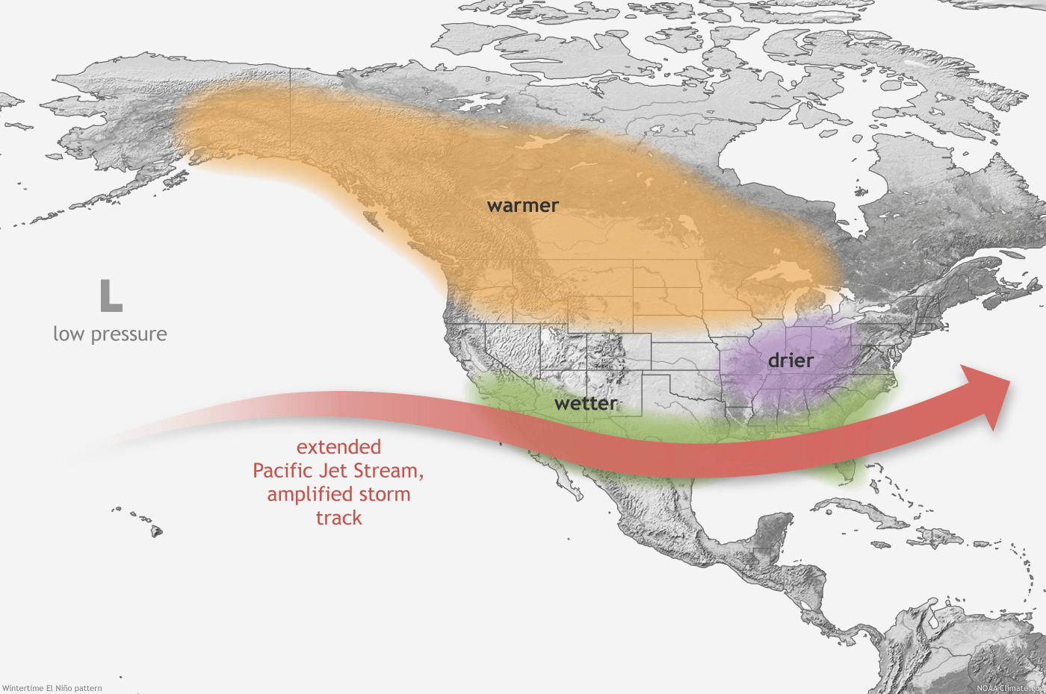
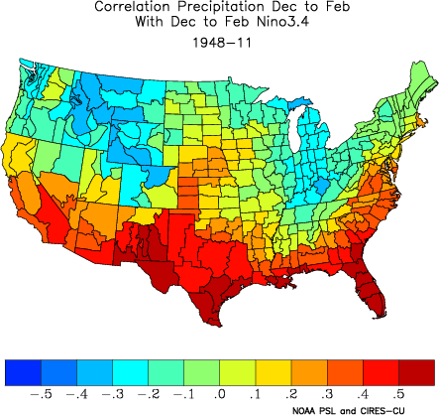
HOW CAN WE USE CORRELATION?
El Nino: Winter Teleconnections in North America
Temporal correlation: Correlation of time series of two variables at same location
Example: Characteristics of crops + precipitation
Spatial correlation: Same times, variables at different locations
Example: Ocean temperature in Pacific and precipitation in the United States – teleconnections
Top image courtesy of NOAA’s National Weather Service: https://www.weather.gov/images/fwd/climate/enso/ElNino_winter.png
Bottom image courtesy of NOAA’s Physical Sciences Laboratory, produced at: https://psl.noaa.gov/data/usclimdivs/correlation/

Slide 2
HOW CAN WE USE CORRELATION?
Spatial or temporal autocorrelation: Correlation of a variable with itself
At a time lag:
An evaluation of persistence of the feature/data
An evaluation of the cyclical nature of the data
At a different location:
An evaluation of spatial patterns

Slide 3
CAN I TAKE A CORRELATION OF TWO TIME SERIES?
What can cause problems
If your data within a time series has persistence, aka serial correlation, the observations within a series aren’t independent from each other – violates assumptions
Option: use averages over persistence time periods so your observations are more independent
Option: use observations over a particular time period for many years (e.g., average Jan var1 over last 100 years vs. average Jan var2 over last 100 years)

Slide 4
CAN I TAKE A CORRELATION OF TWO TIME SERIES?
What can cause problems
If your data in both time series have a trend
Spurious correlations: when two sets of data appear to have a strong relationship, but it’s due to a confounding third factor
Example: shark attacks + icecream – both may increase as summer progresses!
Option: detrend each time series (linear regression with time as the independent variable)
Time series data can also have seasonality, and/or less predictable patterns
Seasonality: predictable patterns that recur at <= 1 year intervals
Option: remove seasonality

Slide 5
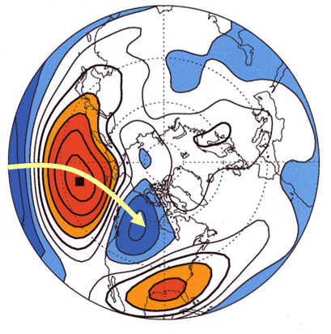
MORE ON SPATIAL CORRELATION
Simple expression of spatial relationships: (single-point) correlation map
Correlation map:
a map showing how a quantity at one location is related to quantities at various other locations
or how an external quantity is related to quantities at various locations
Correlation map of 500 mb heights. Black dot in the Pacific Ocean is the location to which all correlation to other locations are calculated. Red shades are positive correlations, blue negative. Ignore the yellow arrow!
Image courtesy of https://training.weather.gov/pds/climate/pcu2/statistics/Stats/part2/Corr_Space.htm (Prashant Sardeshmukh, CDC/OAR)

Slide 6
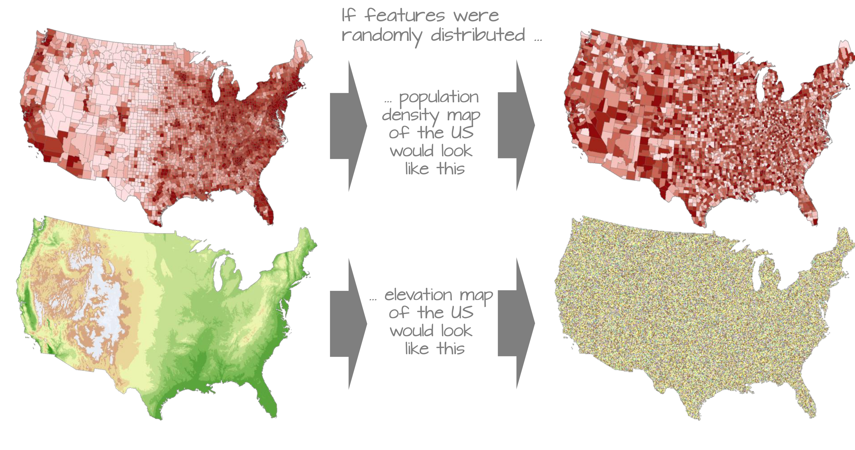
MORE ON SPATIAL CORRELATION
MORE ON SPATIAL CORRELATION
Can calculate Moran statistics - quantifying how much similar features are clustering/where
Correlation coefficient between a quantity
and its surrounding values
Different techniques for defining
“neighbor”
Global and local versions
Courtesy of Intro to GIS and Spatial Analysis, by Manuel Gimond; https://mgimond.github.io/Spatial/spatial-autocorrelation.html
(License: https://creativecommons.org/licenses/by-nc/4.0/legalcode)

Slide 7
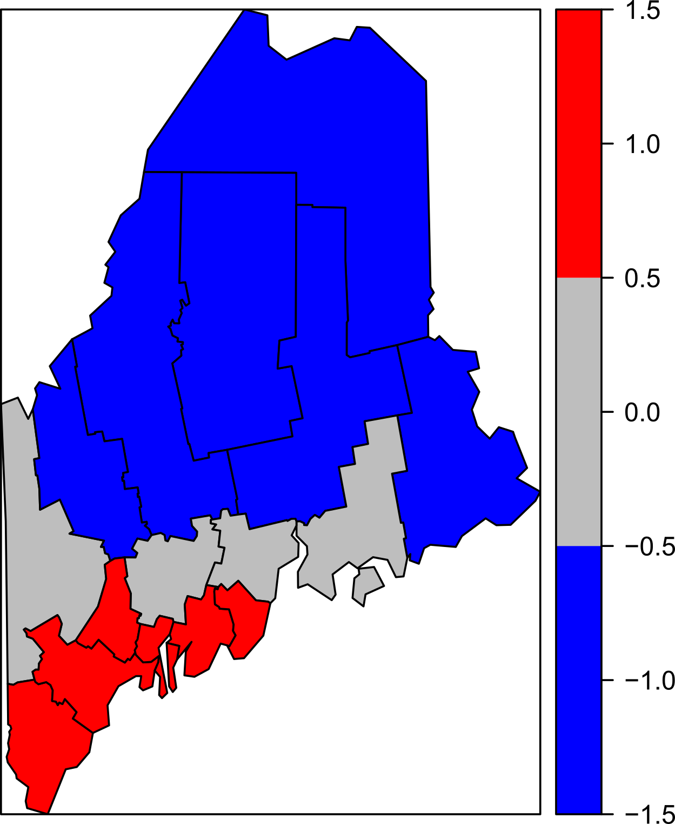
MORE ON SPATIAL CORRELATION
Can calculate Moran statistics - quantifying how much similar features are clustering/where
Correlation coefficient between a quantity
and its surrounding values
Different techniques for defining
“neighbor”
Global and local versions
“Red points and polygons highlight counties with high income values surrounded by high income counties. Blue points and polygons highlight counties with low income values surrounded by low income counties.”
Courtesy of Intro to GIS and Spatial Analysis, by Manuel Gimond; https://mgimond.github.io/Spatial/spatial-autocorrelation.html
(License: https://creativecommons.org/licenses/by-nc/4.0/legalcode)

Slide 8
NOTE:
--> Identifying statistical relationships between variables is not only useful for further evaluation and prediction
BUT
--> Also for making well-informed choices for your machine learning models!

